Slide 1
EVERY CHILD A READER UPDATE
Instructional Services
Governing Board Presentation
Notes:
Insert photos

Slide 2


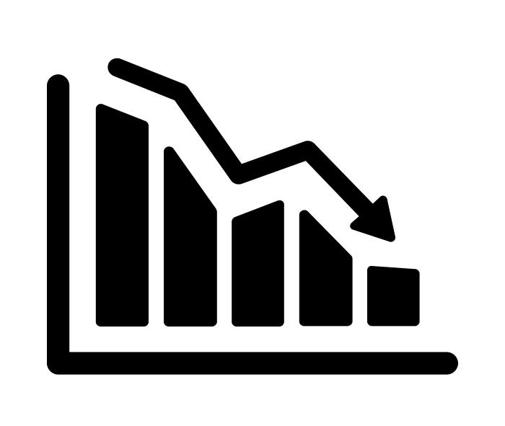

Our Journey…
Data consistently demonstrated we weren’t reaching all students.
Team attended Amplify Forum
Applied improvement science approach to problem
Hosted experts in the field as guest speakers
Met with K-2 teachers to analyze problems
Classroom observations across the system identified Guided Reading as the primary teaching strategy.
Exploring Research to Avoid “Solutionitis”
District PD for all K-2 Teachers on CKLA Implementation, LETRS OR integration of Benchmark and CKLA
Piloted DIBELS as an assessment tool aligned to new curriculum
CKLA became core curriculum for all K-2
Reading boot camp aligned to specific student skill gaps.
Intervention and Assessment Alignment
Jan -Jun 2017
2017- 2018
2018- 2019
2019
K-2 Professional Development to share and explore research on the science of reading.
Elicited teacher feedback on strengths and weaknesses of adopted curriculum in regards to phonics
Identified need for systematic phonics program.
Began initial pilot of CKLA for K-2 teachers.
Offered training for administrators on our findings aligned to research.
Full implementation of DIBELS (K-2)
LETRS Cohort 2 (and continuation)
Shift in Reading Intervention to K-2
Reading Apprenticeship training for middle school teachers
CKLA
Curriculum and LETRS
Recognizing a Need
Notes:
Image Sources:
decrease by Alice Design from the Noun Project
Magnifying Glass by Danilo Gusmão Silveira from the Noun Project
solution by Adrien Coquet from the Noun Project
Target by Hrbon from the Noun Project

Slide 3
Research Guides our Practice
“Brain research isn’t making its way into elementary classrooms. The prevailing approaches to reading instruction in American schools are inconsistent with basic things scientists have discovered about how children learn to read.” - Emily Hanford
Guiding Researcher Support:
Dr. Louisa Moats, Literacy Expert, Harvard Professor
Tim Shanahan, University of Illinois
David Liben, Curriculum Designer/Reading Expert
Dr. Freddie Hiebert, Educational Researcher
Notes:
Hanford, Emily. “Why Aren't Kids Being Taught to Read?” Why Aren't Kids Being Taught to Read? | Hard Words | APM Reports, APM Reports, 10 Sept. 2018, www.apmreports.org/story/2018/09/10/hard-words-why-american-kids-arent-being-taught-to-read.

Slide 4
Data to Determine Impact
Identified multiple metrics used to monitor growth:
DIBELS
iReady
SBAC Reading Claim data
Response to the Data:
Plan and implement appropriate interventions
Interventions matched to identified skill gap/s
Determine professional development needs around first instruction
Notes:
.

Slide 5
DIBELS DATA Fall 2019: Composite Scores
SITE | K % At or Above Benchmark | 1st % At or Above Benchmark | 2nd % At or Above Benchmark
District | 53% | 65% | 62%
Blackford | 39% | 48% | 39%
CSI | 54% | 68% | 67%
Capri | 52% | 69% | 65%
Castlemont | 51% | 57% | 60%
Forest Hill | 74% | 90% | 92%
Lynhaven | 54% | 66% | 51%
Marshall Lane | 70% | 90% | 83%
Rosemary | 18% | 19% | 20%
Sherman Oaks | N/A | N/A | N/A
Village | 65% | 64% | 70%

Slide 6
DIBELS DATA Fall 2019:
Phonics (Letter Sounds)
SITE | K % At or Above Benchmark | 1st % At or Above Benchmark | 2nd % At or Above Benchmark
District | 41% | 48% | 57%
Blackford | 28% | 21% | 37%
CSI | 46% | 51% | 70%
Capri | 40% | 45% | 57%
Castlemont | 33% | 39% | 55%
Forest Hill | 63% | 74% | 83%
Lynhaven | 40% | 57% | 47%
Marshall Lane | 63% | 76% | 76%
Rosemary | 10% | 13% | 15%
Sherman Oaks | N/A | N/A | N/A
Village | 45% | 33% | 56%

Slide 7
iReady Phonics 3rd Reading Data
SITE | 2018 Winter %Proficient | 2019 Winter % Proficient
District | 68% | 71%
Blackford | 54% | 49%
CSI | 69% | 88%
Capri | 79% | 78%
Castlemont | 82% | 68%
Forest Hill | 91% | 91%
Lynhaven | 52% | 57%
Marshall Lane | 87% | 89%
Rosemary | 34% | 51%
Sherman Oaks | 41% | 55%
Village | 83% | 88%

Slide 8
SBAC 2019 Reading Claim Data
Baseline Data
Site | Above/Near | Site | Above/Near
District | 75% | Forest Hill | 94%
Blackford | 60% | Lynhaven | 60%
CSI | 72% | Marshall Lane | 93%
Capri | 79% | Rosemary | 47%
Castlemont | 85% | Sherman Oaks | 59%
 |  | Village | 89%

Slide 9
Celebrations
CKLA implementation has led to data showing a decrease in the number of students with phonics gaps by 3rd grade.
100% of students in 3rd grade are proficient in phonological awareness!
The percentage of students performing two or more grade levels below is decreasing.
We are seeing very positive data shifts in some areas at Rosemary and Sherman Oaks.
Reading Apprenticeship program.

Slide 10
Teacher Leadership Celebrations
Thought Exchange Comments:
“We are teaching the needed skills for kids to be strong readers in the future”
“We are teaching kids the code to reading.”
“I think our continued focus on ECAR is working well.”
“The shift to systematic phonics and consistency with a curriculum to support it is working.”
“I appreciate that we are making sure all students are getting foundational skills, and that we’re using Dibels in K-2.”
“We need all grade levels effectively implementing CKLA to make sure kids get all of the curriculum they need in reading.”

Slide 11
More Teacher Voice: LETRS Feedback
“I would love to see more teachers take this PD, the course was amazing. I better understand the science behind reading and how to help my students.”
“It should be required for all teachers to help better understand why we are doing CKLA.”
100% would recommend to a colleague
75% of year 1 participants took the year 2 class, even with a lower teacher stipend
Notes:
75% of the teachers took year two, 100% said they would recommend it to a colleague. we have a new cohort that includes teachers outside of the K-2 grade span, TOSAs and reading intervention teachers.

Slide 12
Current Challenges
Not all staff believe the changes are best practice.
Need more monitoring on the integrity of implementation.
Additional time is needed for training and observing CKLA in colleagues classes to improve creativity.
Staff members need to dig deeper into data and create response plans at point of struggle.
Keeping the focus on reading as we engage in other areas of work: NGSS and Math.

Slide 13
Next Steps
Publish and celebrate data in PLCs so that staff can see the benefit of this change for our students.
Improve systems of intervention for all grade levels.
Begin to use DIBELS progress monitoring tools to respond to more quickly when students struggle.
Continue focus on going deeper with the work and sharing research to ensure 100% buy in.

