Slide 1
Fall 2019 Thoughtexchange Results Overview
LCAP Goal: Community Engagement
Governing Board Presentation
January 9, 2020

Slide 2

LCAP GOAL: Stakeholder Engagement
Fully engage parents/guardians, students and the community in support of student educational outcomes.
Thoughtexchange
One of the ways we elicit feedback
from stakeholders
One open question; many thoughts
Results are one of many measures used to update/develop LCAPs
Notes:
Part of our annual planning
Helps us understand what is important to the people affected by our decisions.
Thoughtexchange is one of the ways
an online tool that allows us to reach many more people and learn their thoughts and priorities.
More Ratings = More Salient Thoughts
We read all of the thoughts
Can follow up on questions that arise

Slide 3
Participation Observations
Jan. & April 2018 | Parents | Staff | Students 3-8
People | 1,077 | 300 | 5,113
Thoughts | 2,703* | 0 | 13,740
Ratings | 25,756* | 0 | 267,944
Dec.-Jan. 2019 | Parents | Staff | Students 3-8
People | 947 | 325 | 3,825
Thoughts | 1,005 | 426 | 10,006
Ratings | 11,355 | 9,182 | 216,931
Oct.-Nov. 2019 | Parents | Staff | Students 3-8
People | 1,024 | 539 | 3,933
Thoughts | 995 | 484 | 8,282
Ratings | 17,352 | 5,760 | 238,610
Learning curve
Different times
of year
Year 1:
All groups answered same questions
Adults in Jan., Students in April
(* Includes staff)
Notes:
People: Average 1,000 parents (Less at holiday time- no surprise)
Ratings: Average 23,000 for parents and staff
Parent/Community Participation
higher than what we used to get at on-site meetings
greater in range of topics and perspectives
about even with the previous 2 exchanges

Slide 4
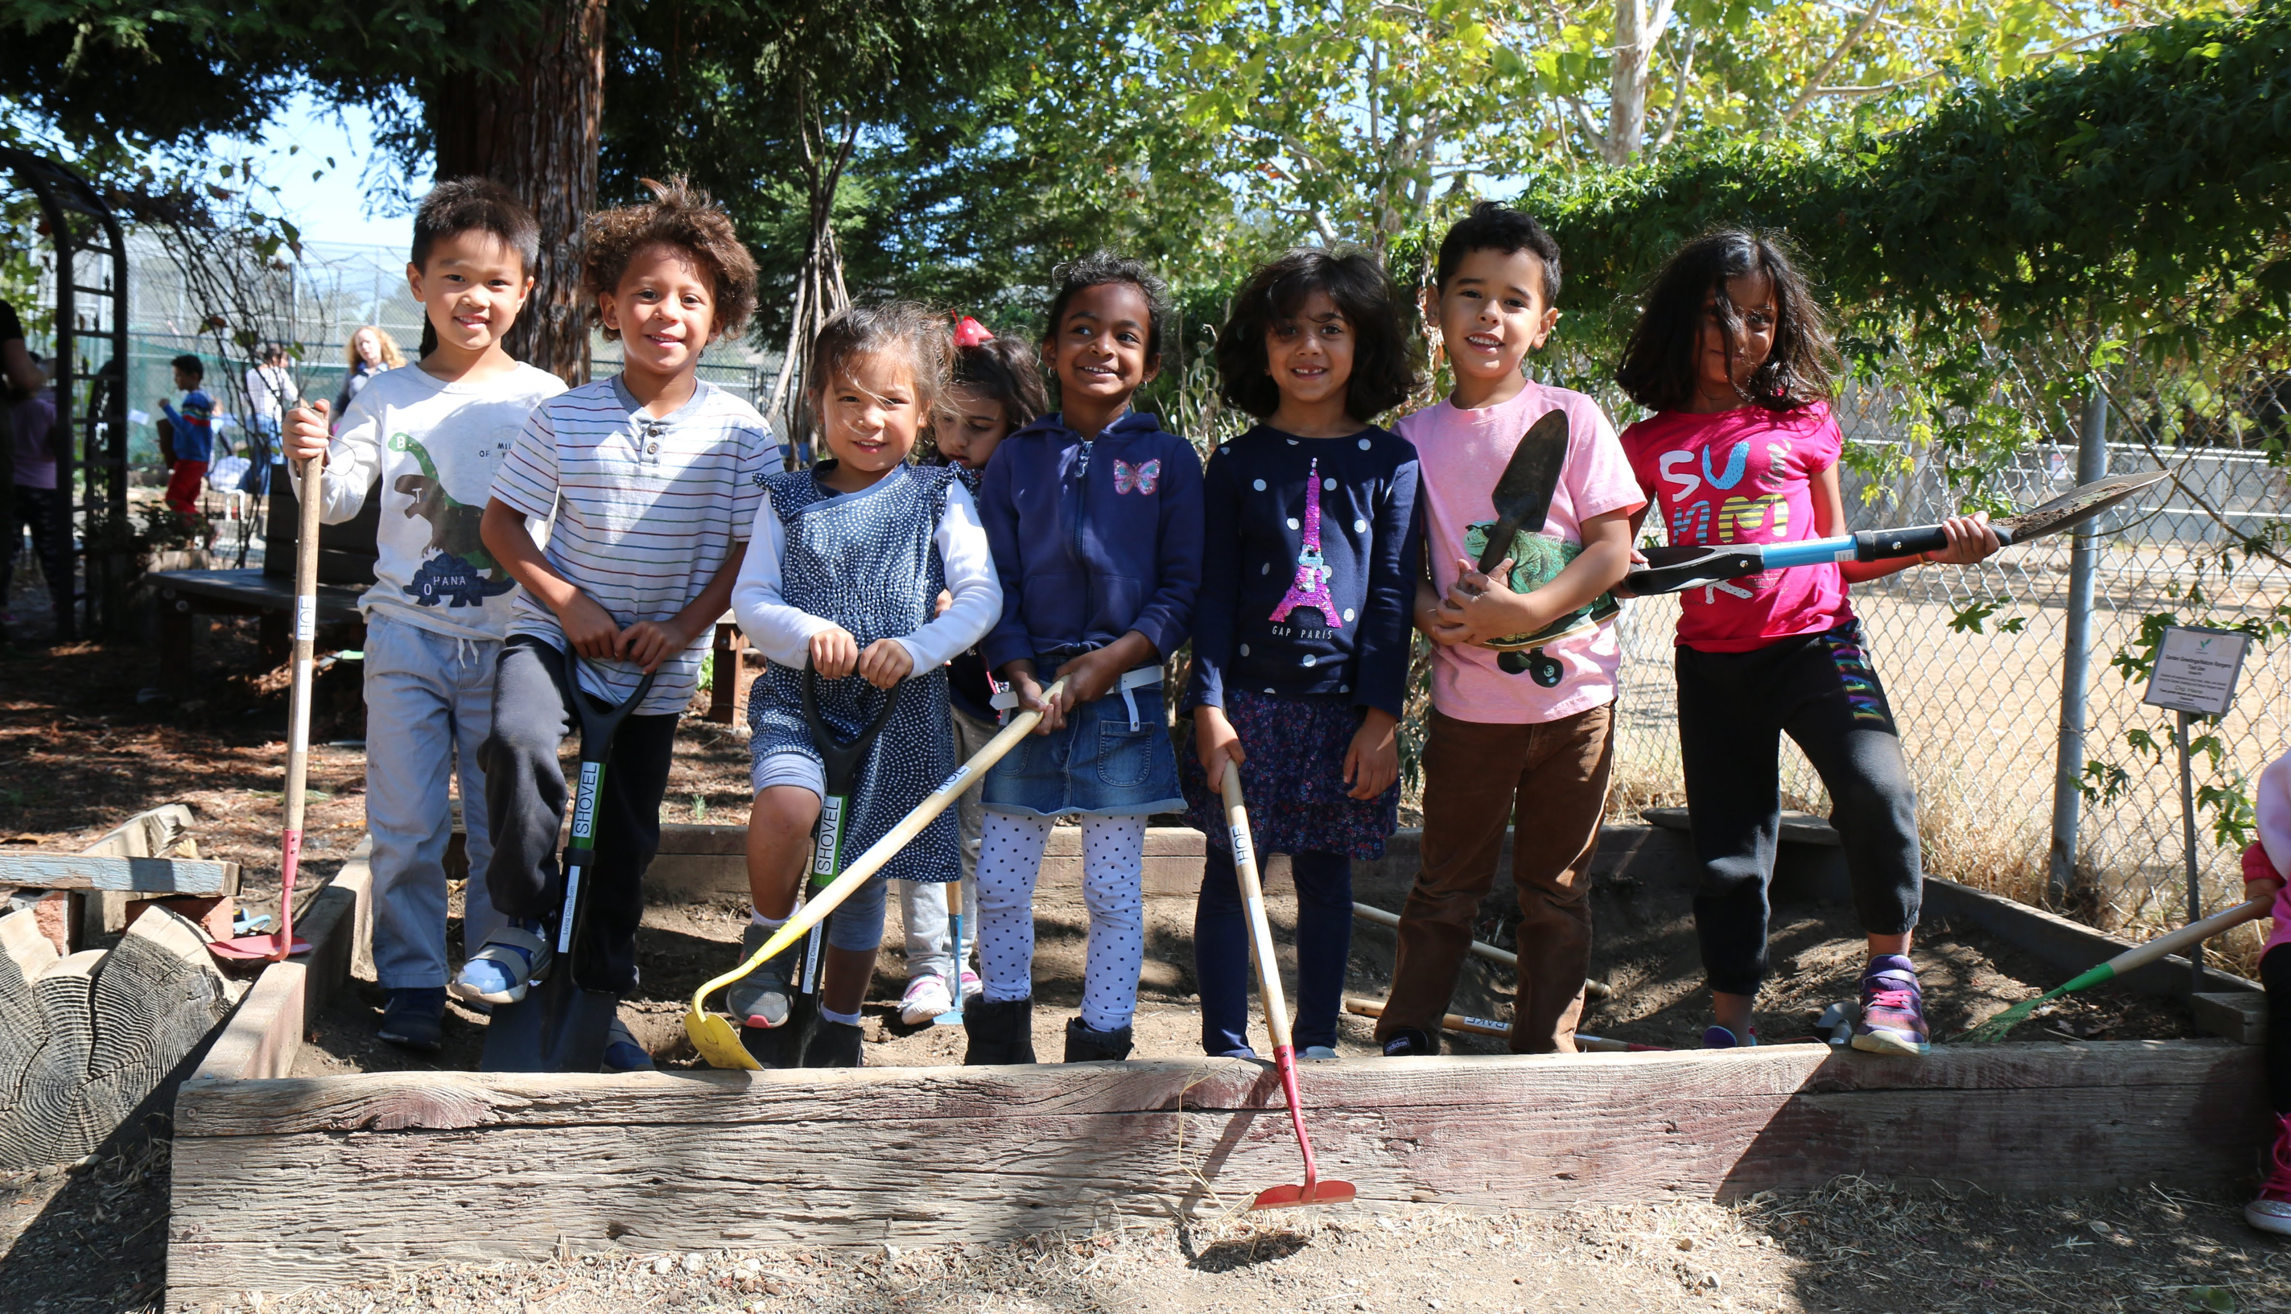
District Themes: Parents/Community
2019-20 PLUS!
Seesaw
Supplemental programs (art, gardens, project cornerstone)
Focus on future-ready skills (empathy, collaboration, etc.)
2019-20 DELTA
More after-school programs and interventions
Improve lunches
More programs for advanced learners
Notes:
District admins read all thoughts.
Identify areas for action, clarification Each school leadership team will look through their respective results fo site-level themes.

Slide 5
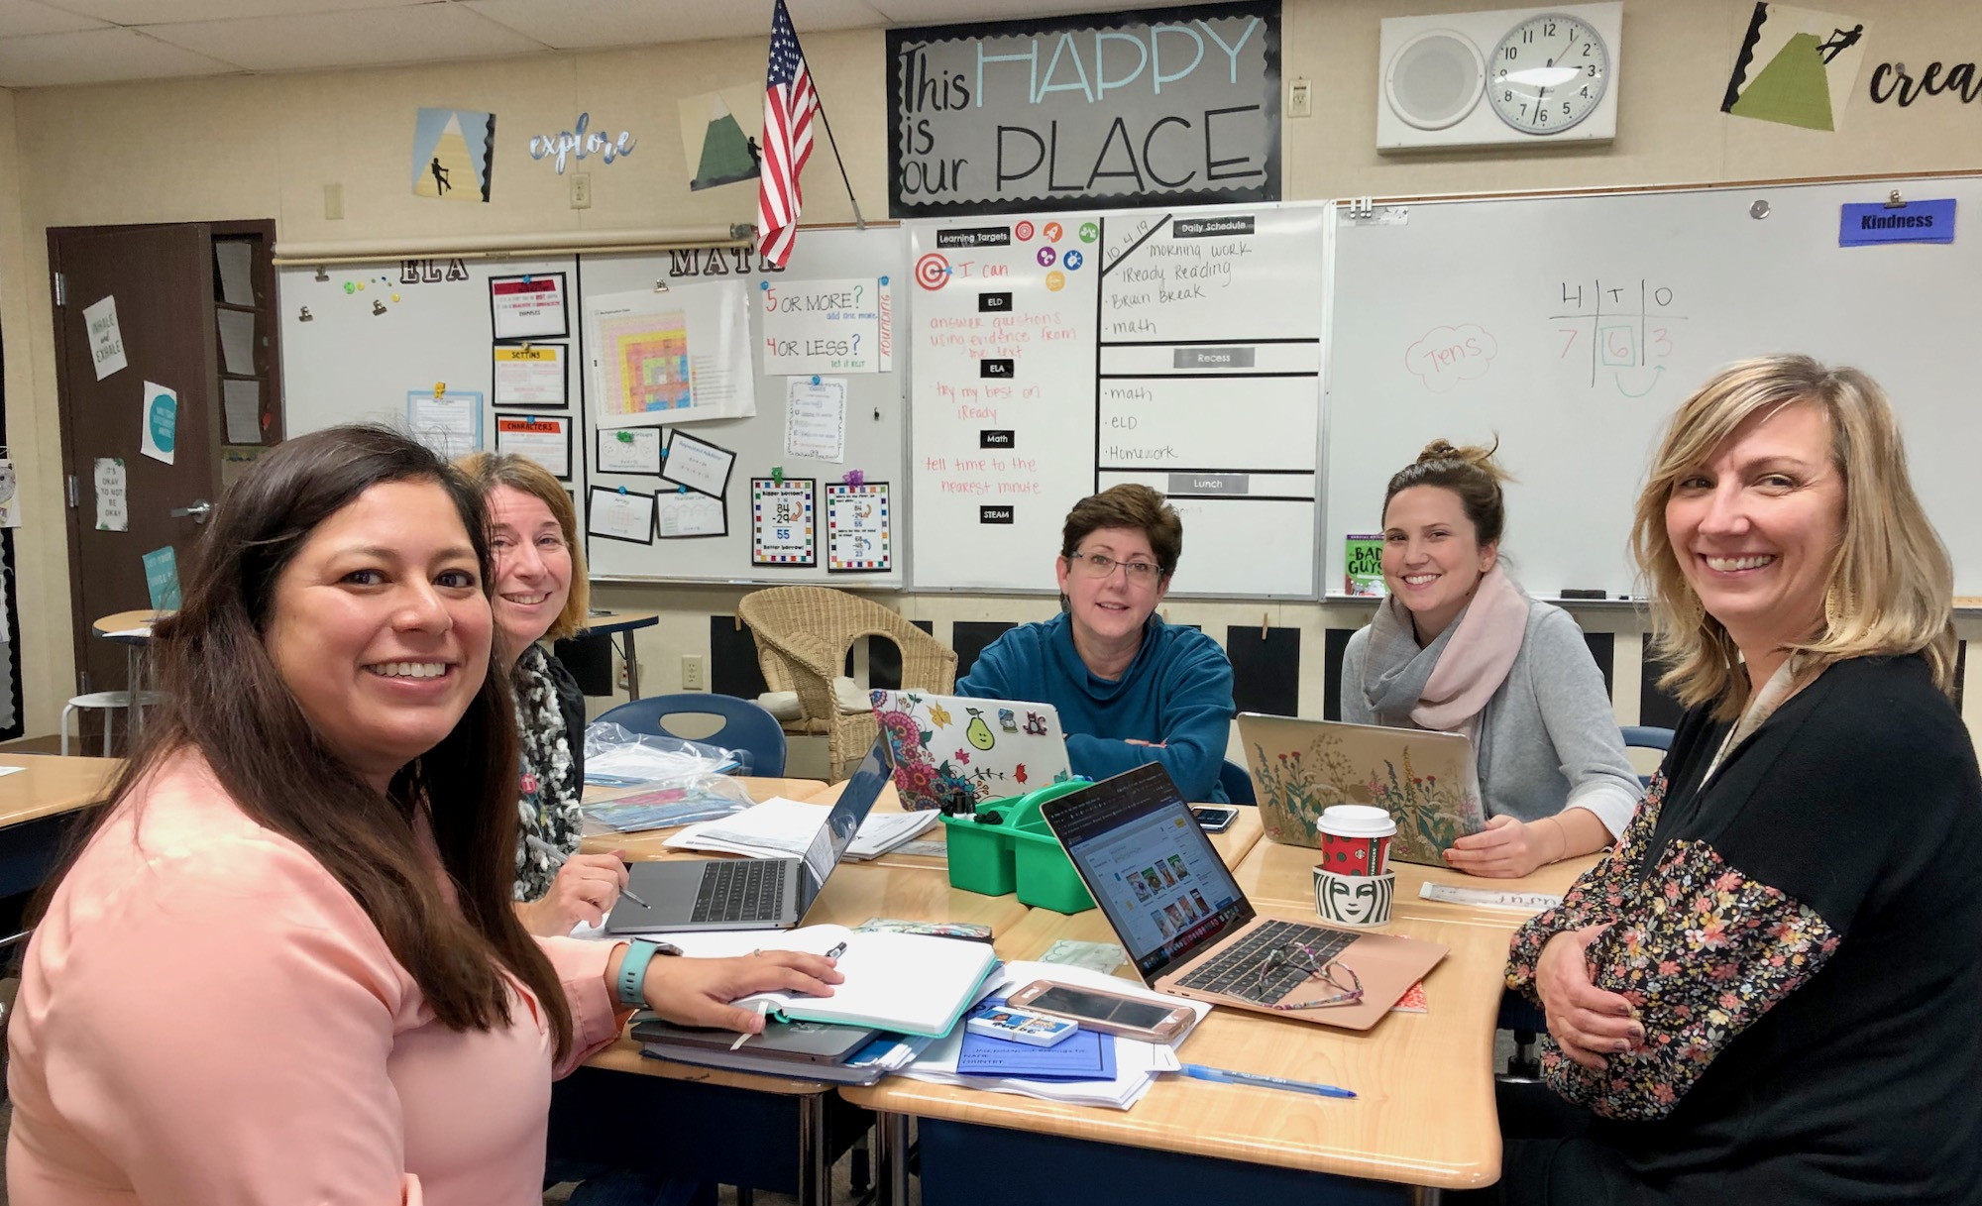
District Themes: Staff
2019-20 PLUS
Site-based Professional Development
Increased shared leadership and decision making
Teaming and collaboration
2019-20 DELTA
More of items under “Plus”
More intervention support
More PLC time

Slide 6
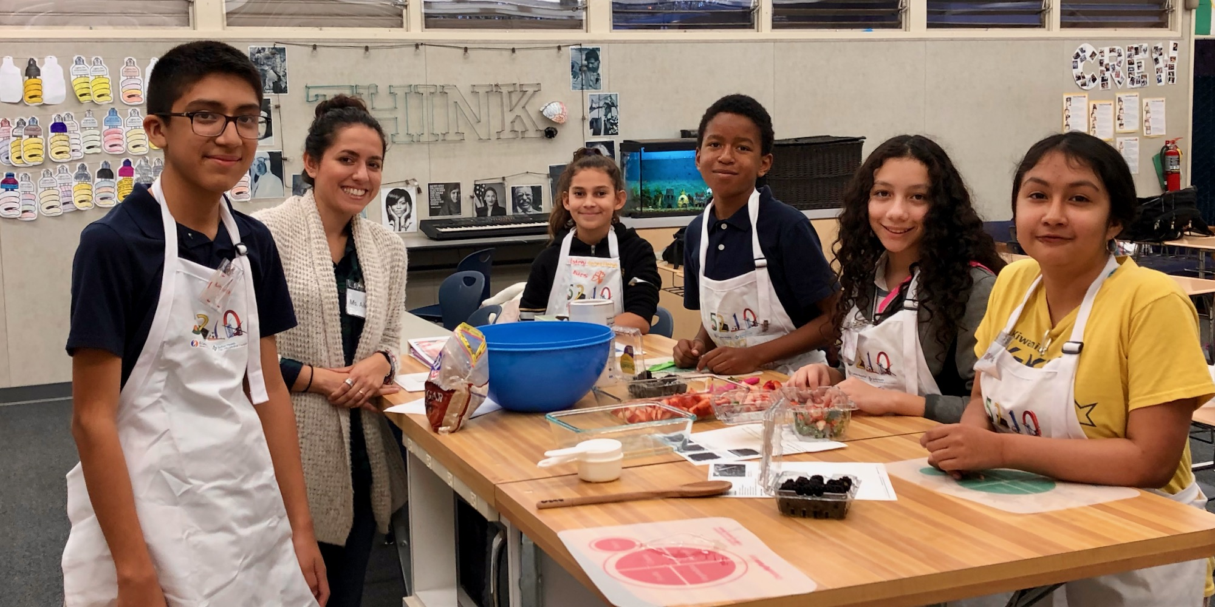
District-wide Themes: Students
2019-20 PLUS
Field trips
PE/Playworks
Various programs (e.g. Mystery Science, AVID, Kahoot, afterschool programs)
2019-20 DELTA
More of items under “Plus”
Cafeteria food
Longer breaks/recess/lunch

Slide 7
How District Used Past Results
Top thoughts in Past Exchanges:
More field trips
More Social-Emotional Learning (SEL)
More parent education opportunities
LCAPs show:
Funds allocated for field trips at district and site level
Increased SEL supports/training for schools and staff
Increased parent ed. through partnerships

Slide 8
Using & Sharing the Feedback
Review and analyze district and school-level feedback.
Share reports – schools and district
  Student Groups: Student Advisory Groups (School & Supt)
  Parent/Community Groups: Supt’s Parent Advisory Committee, DELAC, Site Councils, etc.
  Staff Groups: Instructional Leadership Teams, Faculty Senate, Bargaining Units, etc.
Incorporate feedback into LCAPs and budget development
Communicate to families/public (web, newsletters, meetings)
  Sites to track how they used the feedback and communicate what changes were made
Example of use is in an upcoming presentation.

Slide 9
Timeline
December 2019: Generate reports; Administrators review/analyze data and plan communication rollout at sites; Share with Superintendent Parent Advisory Committee
January 2020: Results published on District website and newsletters; School admins begin sharing data with key groups (staff, parents, students)
January – May 2020: Site leadership teams use the feedback along with other data to develop school plans; Communicate to stakeholders what decisions were made.

Slide 10
Next Steps
Increase participation among parents/community
  Devices available at school events
  Community liaison support
  Avoid holiday scheduling
Enhance communication
  Provide communication tools and schedule for
  schools to share how input is used in decision making
Expand Thoughtexchange use at school level
  Allow for more site-based inquiries
  More targeted feedback

Slide 11
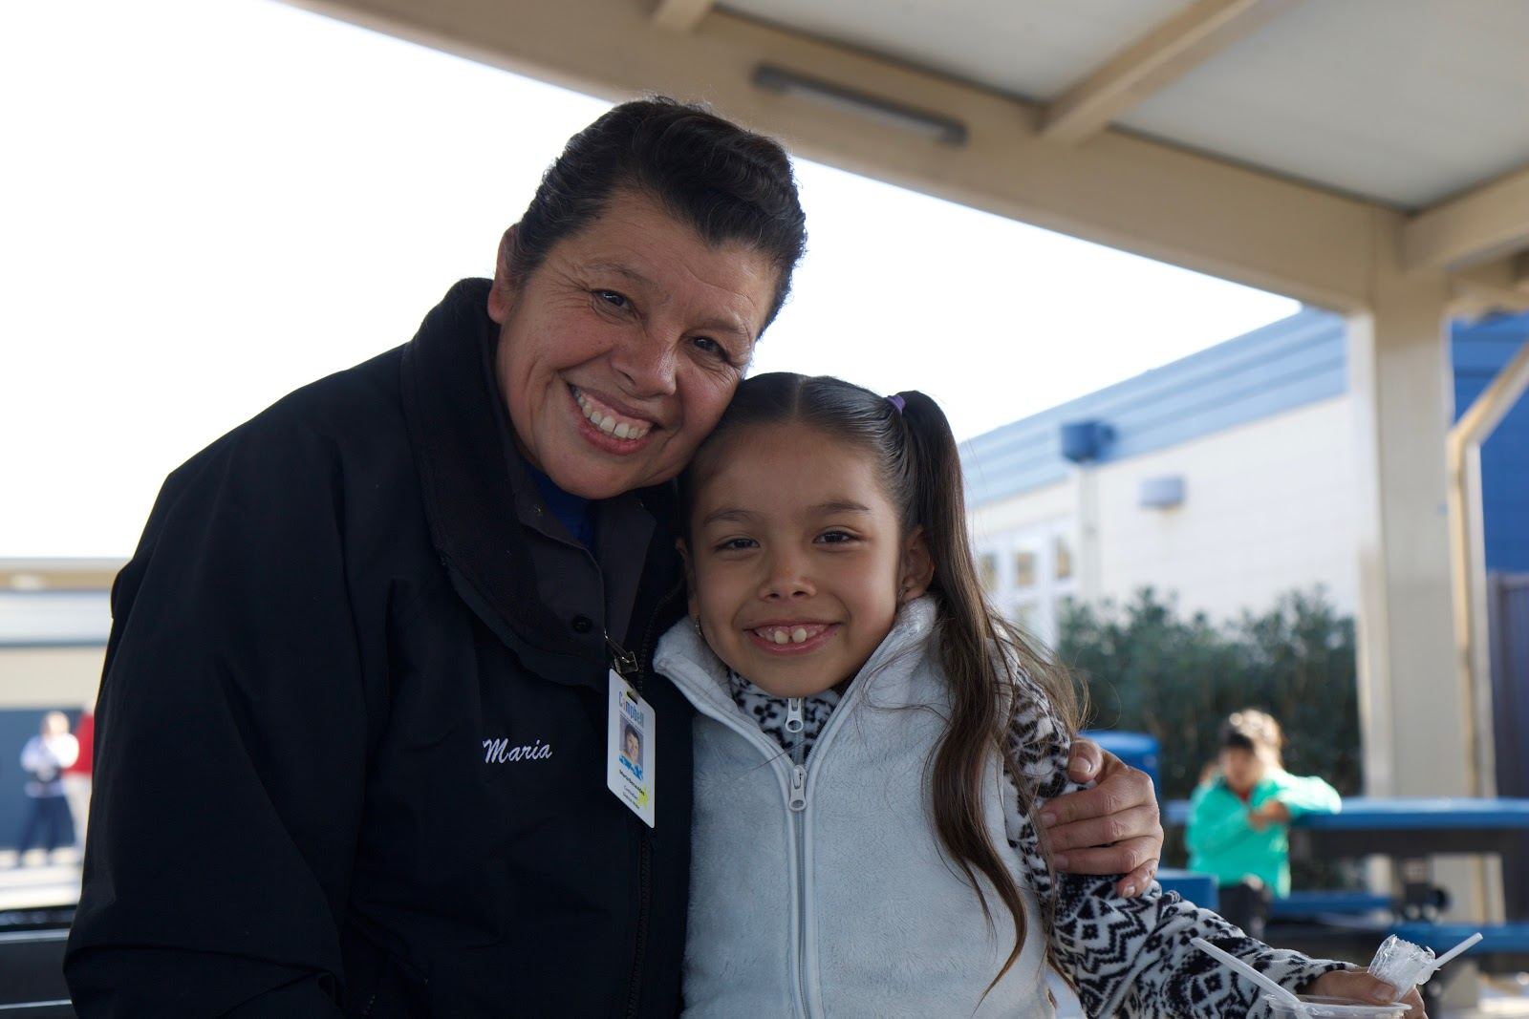
Public Reports Go Live in January 2020
Parent-Community Voice
Student Voice
Staff Voice

