Slide 1
2015 – 2016
Local Control and
Accountability Plan Process
Campbell Union School District

Slide 2

Local Control & Accountability Plan (LCAP)
Intent
  District and Community Input in Plan Development
  Transparency of Local Control Funding Formula $
  Oversite of the LCAP
State Board of Education LCAP Rubric
  January/February
State Board of Education
LCAP Template
  Late Spring

Slide 3
Role of the School Board
The school board must “consult with teachers, principals, administrators, other school personnel, local bargaining units of the school district, parents, and pupils in developing a local control and accountability plan” (EC 52060(g))

Slide 4
Role of the School Board
The school board must hold at least one public hearing with an opportunity for public comment and recommendations regarding the specific actions and expenditures proposed in the LCAP or annual update (EC 52062(b)(1))

Slide 5
Role of the School Board
The school board must adopt the LCAP or annual update and the district’s budget at a separate public meeting, with an opportunity for public comment and recommendations on the LCAP (EC 52062(b)(2))

Slide 6
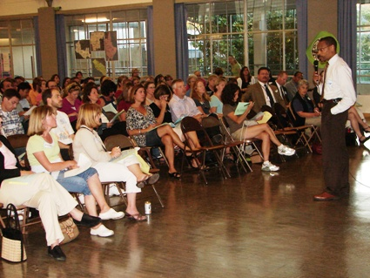
LCAP Development Process – 2015-16
January-February 2016
District-wide LCAP input meetings
  January 12
  9 – 10:30 AM (Busing Provided)
  6:30 – 8:00 PM
  January 19
  6:30 – 8:00 PM
DELAC LCAP meeting
Site based LCAP meetings
April-May 2016
LCAP drafts to Board for public hearings
June 2016
Completed LCAP (by June 1)
Notes:
Danielle - Explain the process

Slide 7

Local Control & Accountability Plan (LCAP)
Questions? Comments?

