Slide 1
Rosemary School Local Control & Accountability Plan
Instructional Services
Governing Board Presentation
June 2, 2016

Slide 2
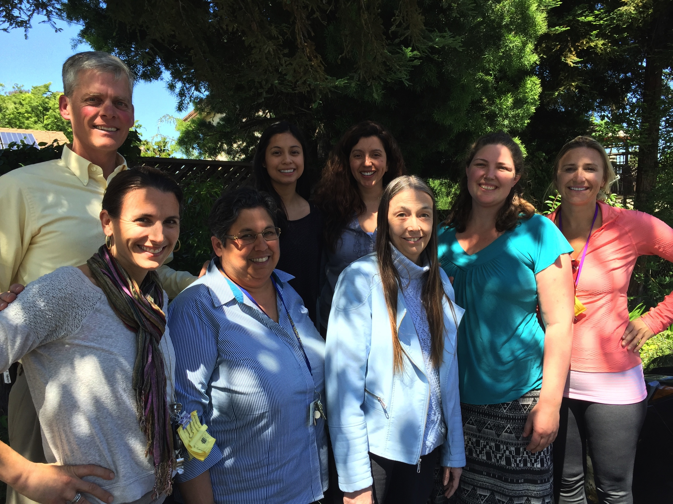
Rosemary School Instructional Leadership Team (ILT)
Katie Salinas, Equity Coach,
Michele Benedetti, Intervention Specialist,
Roberta Martinez TK,
Liza Mendes ELD Champion,
Claudia Gallaher, 1st grade,
Melissa Morales, 2nd grade,
Julie Hart 3rd grade,
Andrea Lawryk Tech Integration Coach, 4th grade,
Brian Schmaedick, Principal

Slide 3
Rosemary: Goal 1, Standards
Progress towards goal:
Full school-wide commitment to Professional Learning Community (PLC) process
Weekly grade-level planning, grade-level PLC and planning days
Integrated & Designated English Language Dev. Prof. Dev.
Writers’ Workshop Prof. Dev.
Regular classroom observations
Next Steps:
Focused PD on Common Core standards and on developing student-friendly learning targets
Planning time to develop scope and sequence for new ELA curriculum and for NGSS
Develop scope and sequence for STEAM Integration at all grade levels
Involve teachers in instructional rounds
Notes:
You need to list the main things that were done to support the goal and be prepared to share how you know if you were successful or not. Share what was used to determine success (data, surveys, parent sign in sheets, etc). Share challenges you are facing in completing goals.

Slide 4
Rosemary: Goal 2, Achievement
Progress towards goal:
Intensive intervention program targets both sides of RTI pyramid (academics and behavior) to support all students in meeting learning targets
iReady indicates that we can expect to see larger gains in ELA on SBAC than math
iReady reading data for grades 1 & 2 shows higher percentages of kids on level
Next Steps:
Develop school-wide and grade-level specific achievement goals
PD in developing student engaged assessments and rubrics to give students more investment in meeting learning targets
Increase capacity for intervention in math and make math our focus of PLCs
Identify or create valuable formative assessments
Notes:
How do you know the intervention programs are working? Are kids being exited out? Are you serving a greater percentage of kids in the past?
Rosemary 3/4th graders are out performing overall district growth percentages in ELA. District growth for 3rd grade is 17-ROS is 33%!! Overall district 4th grade 19% vs ROS 21%.
The third bullet is important because that means that you are showing stronger reading skills earlier on. The percentages of 1st graders on level is 35% and 2nd grade is 31%. While still low, this is impressive because your SBAC percentages on grade level for 3rd last year was only 22% and 4th was 25%

Slide 5
Rosemary: Goal 3, Social/Emotional
Progress towards goal :
PD provided on managing extreme behaviors
Playworks, Campus Supervisor, and District staff support Tier 2 & 3 students
School-linked Services and MFTi collaborate closely with school personnel
Development of School-wide Mission, Vision, and Values statements
Next Steps:
Employ Positive Behavior Interventions and Support TOSA to facilitate model tiered systems
School-wide community-building structure for every classroom (i.e. classroom meetings)
Consistently celebrate small victories on the path to meeting our goals

Slide 6
Rosemary: Goal 4: Parent Engagement
Progress towards goal:
School-linked Services Community Liaison is moving mountains
More opportunities for parent education, involvement, and advocacy
Campus Collaborative opens communication between parents and community agencies
Next Steps:
Move from involvement to leadership – Home/School Club
Improve communication with families; digital as well as culturally conscious communication
Continue to address needs identified through the Campus Collaborative process: extra-curricular activities, more library access, etc.

