Slide 1
Village School local Control
& Accountability Plan
Instructional Services
Governing Board Presentation

Slide 2
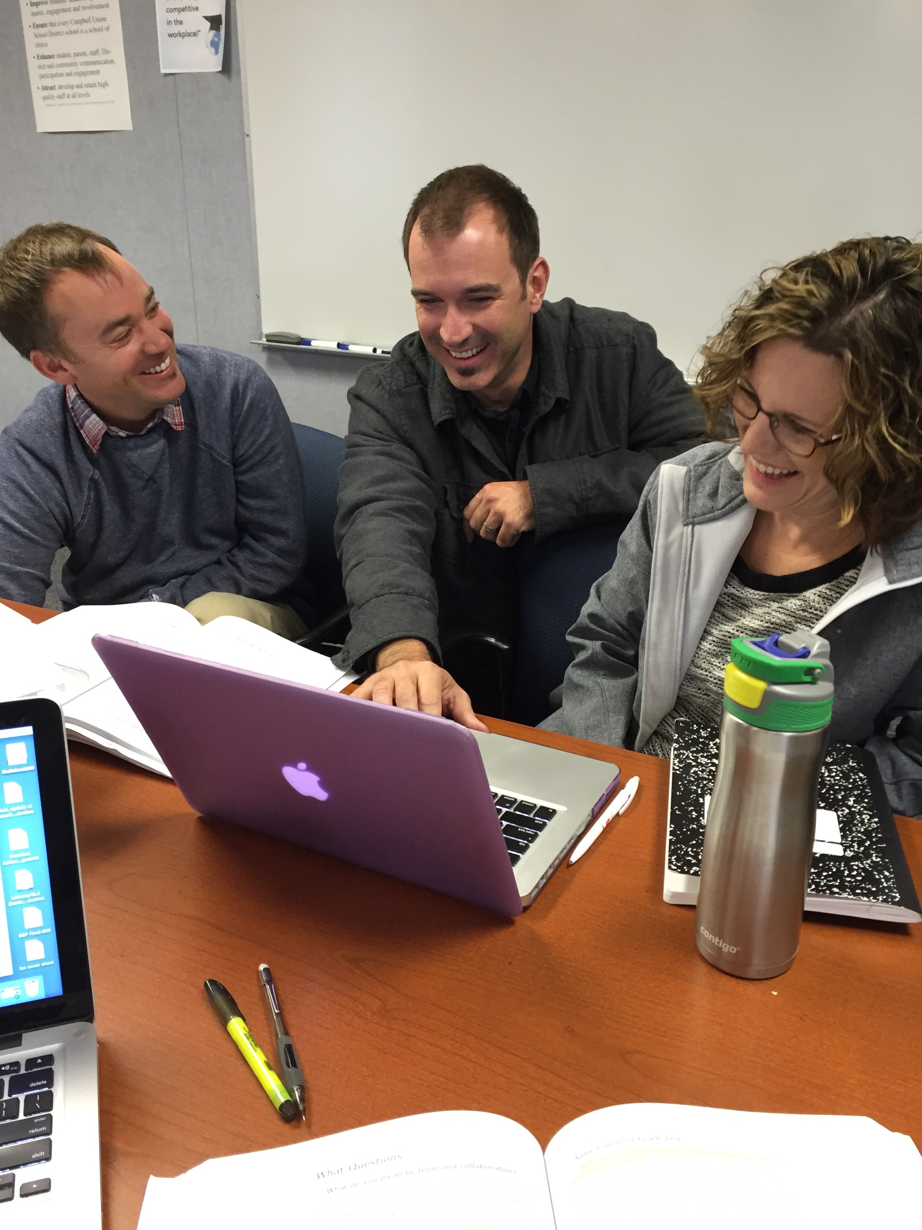
Village School Instructional
Leadership Team
Andy Carbone, 1st Grade,
  Equity Coach
Chris Woods, 2nd Grade
Michele Goetowski,
  4th Grade
Notes:
Andy Carbone, 1st grade teacher .05 fte, Equity Coach .05 fte, Technology Integration Coach, Village School Teacher of the Year 2013 – 14.
Chris Woods, 2nd grade teacher, Instructional Leadership Team, PBIS Tier II, III team member, No Bully Solution Team Coach
Michele Goetowski, 4th gr teacher, Instructional Leadership Team, SSC member both Village and Monroe. Village School Teacher of the Year 2015 – 2016.
Our ILT is moving the work of our Professional Learning Community to include the essential question, “now what” in all collaborative planning. While Village has a rich history of teachers working and planning together – an emphasis of using student work and the result of common formative assessments to guide their planning has been the focus this year.

Slide 3
Village School: Goal 1, Standards
Progress towards goal:
All Village Teachers Using Eureka Math
K – 2 Teachers Piloted CKLA
2 – 3 Teachers Piloted NGSS “Mystery Science”
Technology Integration Using the SAMR Model
STEAM Centers and STEAM Units, Montalvo, Intel, Google
Next Steps:
Prof. Dev. Focus on Tech Integration Aligned to Common Core (CCSS) using the SAMR Model
Pilot New Math Curriculum
K Teachers Using CKLA
1 – 5 Teachers Using Benchmark
Site License for “Mystery Science”
Notes:
The SAMR Model for integrating technology into teaching, developed by Dr. Ruben Puentedura, has gained a good deal of exposure in recent years. “SAMR” is an acronym that stands for Substitution, Augmentation, Modification, and Redefinition.
Continue to dedicate meeting time for PLC and provide 4 site funded release days per year per grade level for collaboration using the PLC model.
1st grade teachers supplementing with CKLA
Challenges involve the sheer volume of new material to be covered – CCCS, New Curriculum, NGSS

Slide 4
Village School: Goal 2, Achievement
Progress towards goal:
Comparing SBAC to iReady
Projected growth flat in 5th math
Significant gains projected for 4th math
Significant growth projected in ELA for all tested grades
Extended Day ELD and ELD Reading Intervention
Emphasis in Prof. Learning Community (PLC) on
“Now What”
Next Steps:
Additional Tech Integration Coach
Aligned CCCS Eng./Lang. Arts (ELA) curriculum for grades 3 – 5
Site based Instructional Rounds incorporating teachers and the PLC model
Utilize district GATE resources to further differentiate instruction
Notes:
Comparing Math iReady data to 2015 SBAC data – Village
3rd grade growth is projected to fall just short of students exceeding or meeting standard, 70% compared to 77% last year
4th grader growth is projected to show dramatic gains 84% compared to 64% last year
5th grade growth is projected to be flat 84% compared to 86%
Comparing ELA iReady data to 2015 SBAC data – Village
Is projected to show significant gains in all tested grades
3rd 76% to 87%
4th 70% to 79%
5th 77% to 92%
Involve Teachers in Instructional Rounds – incorporate into release PLC release days.
.04 fte Reading Intervention Teacher change in schedule will spend 5 mornings a week at Village, aligns with model.

Slide 5
Village School: Goal 3, Social/Emotional
Progress towards goal :
Multi – tiered intervention in place incorporating multiple systems and programs
Project Cornerstone 2016 Asset Champion Winner – Caring School Climate Award
Project Cornerstone ABC Readers – all classrooms
Next Steps:
Positive Discipline refresher for all staff
Project Cornerstone Kids will train all classrooms on 2 non-competitive, inclusive field games
No Bully Solution Team training for families
Principal Chat for students
Notes:
Multi-Tiered approach to fostering a positive school climate
Tier I includes; Positive Discipline, PBIS school wide expectations (Village Values), Project Cornerstone, No Bully Solution Teams and welcome teams. Lunch Leagues including lunch time indoor game room.
Tier II includes; CICO, “No Bully Solution Teams, “Little Girls Can Be Mean” Family Book Club, MFTi Counseling Services,
Tier III includes, Modified CICO, Individual Behavior Plans, MFTI Counseling Services
Project Cornerstone ABC Readers – only 28 schools in the county had 100% coverage in all classrooms. Village is one of the 28.
No Bully Solution Team – is more than treating bullying – it is about prevention – 14 new students participated in Welcome Teams, 3 went to Solution Teams, 13 students participated in the referral process and 6 went to Solution Teams. Almost 70 students participated in Empathy Training from being part of a Solution Team.
SWIS Data is consistently analyzed in both our PSC (PBIS Tier I) and PBIS Tier II and III meetings. Average Daily Referral rate is lower than last year. 5 months the ODR rate is lower than the national median for schools our size and never exceeds the 75th percentile (1 month approaches, December – release of Star Wars).

Slide 6
Village School: Goal 4: Parent Engagement
Progress towards goal:
Communication
Parenting Classes
Classroom participation
Playground supervision
Field trip drivers
STEAM Centers
Lunch League
Spanish Language
Next Steps:
Curriculum
Homework expectations
Systematic supervision
External facing website
Families representing our community

Slide 7

Village, a community of learners…

