Slide 1

Local Control & Accountability Plan
Instructional Services
Governing Board Presentation

Slide 2
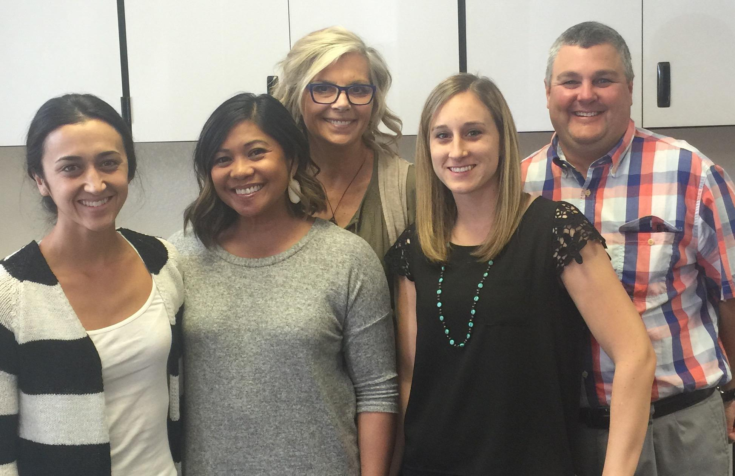
World Famous Castlemont Instructional Leadership Team
Katie Iyama, 3rd grade teacher
Gayl Leones-Cribari, Equity Coach
Amanda Del Real, 5th grade teacher
Ivy Sarratt, Principal (TBR)
Eric Brown, Assistant Principal (incoming principal)

Slide 3
Castlemont: Goal 1, Standards
Progress towards goal:
Strengthening collaborative conversations supporting our Prof. Learning Community (PLC)
K-1: CKLA Reading Curriculum-Teachers piloting Benchmark
EXCEL with Ed Associates support
ELD Support during core instruction
Release time/ Instructional Rounds and ILT
Equity Coach Support for teachers
NGSS Professional Development
STEAM and Technology Integration
Next Steps:
Dedicated staff meetings discussing Professional Learning Community (PLC) implementation
PLC time allocated to curriculum map with differentiation mindset
Instructional Rounds with ILT: grade level leads
Provide additional designated English Language Development (ELD) support in the classroom
NGSS aligned units will be taught once ready from Next. Generation. Science Standards (NGSS) teacher leaders

Slide 4
Castlemont: Goal 2, Achievement
Progress towards goal:
5 Formal PLC cycles using PLC Process
i-Ready data showed 2nd, 4th & 5th grades either met or were above the achievement target in Reading
i-Ready data showed 4th grade above achievement target in Math
2nd - 4th showed increased Math facts fluency with use of the new program: Reflex Math
5th grade math scores projected to be flat on SBAC
Reading Intervention: at least a third of our RI students have seen a year’s growth or more
Next Steps:
Strengthen student driven PLC process school wide with the focus on English/Lang. Arts (ELA)
Provide professional development on how to use the iReady data to drive instruction
Increase the use of Illuminate to create informative common assessments
Investigate if Reflex math is having a positive correlation to SBAC and iReady scores
RI teachers formally meet with teachers and Equity Coach

Slide 5
Castlemont: Goal 3, Social/Emotional
Progress towards goal:
School-wide PBIS training & modeling
Office Referrals decreased by 34%
Dynamite Dragon Spirit Assemblies & Principal’s Dragon’s Medallion Award
Tier 2: Identify and support with counseling services
Student Leadership Opportunities
Outside music before school provided by Rhythm & Moves
Alternative Recess: Dragon’s Den
Digital Dragons & Student Council
Jump Rope for Heart, Annual Talent Show
Next Steps:
Review PBIS language K-1st: Stop, Talk, Walk
Using PBIS data to plan Professional Development around strategies to best support struggling students
Tier 2: Earlier identification and provide 1:1 and group support from MFTi, Counselor and school psychologist
Playworks: revisit daily structure to be more inclusive and consistent to 3 Rs.
Continue with climate activities and events and add opportunities for students to demonstrating learning publically
Notes:
Removed the bullet that listed out all of the PBIS systems as you can address a few when you talk about bullet one. There was a lot of text on the left side and print was small. I feel like the items listed are too many and too specific. I can hear the question: How do you know these things work?
This slide needs to address the Mulit-tiered systems of support. Do you use counselors, pychs, to meet the needs of students? That should be listed here and perhaps delete some of the activities you do. They will want to know about the impact of those activities.

Slide 6
Castlemont: Goal 4: Parent Engagement
Progress towards goal:
Active Home and School Club (HSC) focus on fundraisers & hosted 3 Family Learning Nights
Wide variety of annual events
Common messages shared in multiple ways
Community Liaison - focus on outreach to new and non-English speaking families
Next Steps:
Computer access for parents
in library
Increase parents subscriptions
to Peachjar and site newsletter
Create awareness for parents on how to utilize the emailed communications
Increase Parenting Skills Classes
Recruit more parents to LCAP meetings to get increased feedback

